Slide 1

Fraud Detection in Financial Institute

Slide 2
Content of Presentation
Business Problem
Data Question
Machine Learning Process
Exploratory Data Analysis Findings
Model and Evaluation
Summary

Slide 3
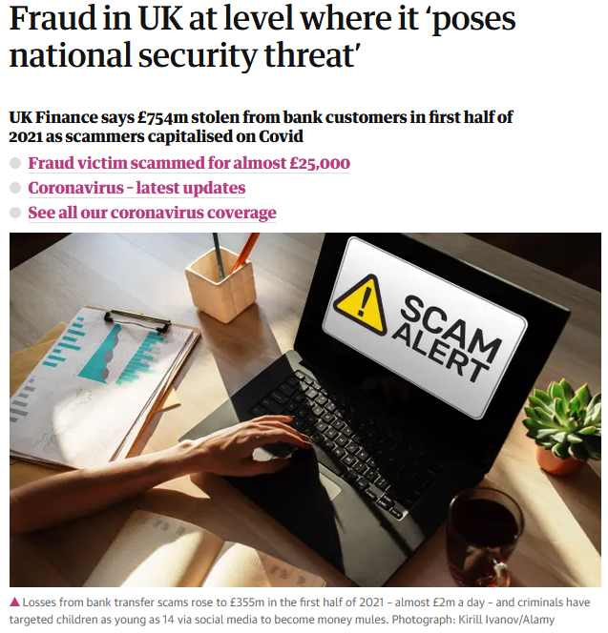
Did you know?
Financial institute loses about 5% of their total revenue to fraud
This is an increase of over 30% in the same time period compared to 2020
Source: The Guardian

Slide 4
Business Problem
Financial institute are losing money due to frauds and their reputation is on the line, can fraud be detected and prevented to reduce loss in revenue
Data Question
How can we identify fraudulent transactions using the dataset?
Using various machine learning algorithms to find the one with the highest accuracy for fraud prediction, and more importantly can fraudulent transaction be predicted?

Slide 5
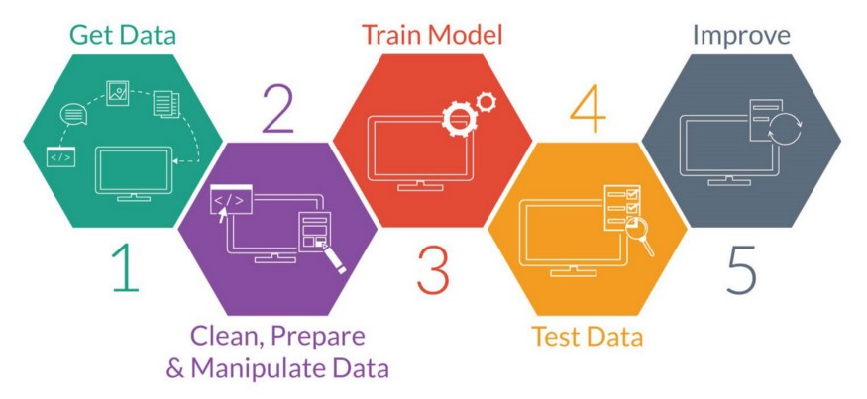
Machine Learning Process
Data Source: Kaggle
Synthetically generated banking transaction by PaySim

Slide 6
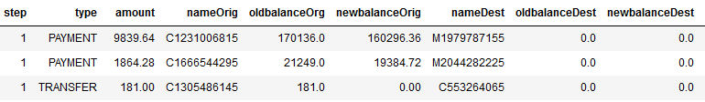
Exploratory Data Analysis Findings
Only TRANSFER and CASH_OUT transactions have fraudulent transaction
There are erroneous data in the account balances

Slide 7
Imbalanced Dataset
In the dataset of over 2 million records, only about 8000 records
We used resampling techniques to balance the distribution and check if that would help with prediction

Slide 8
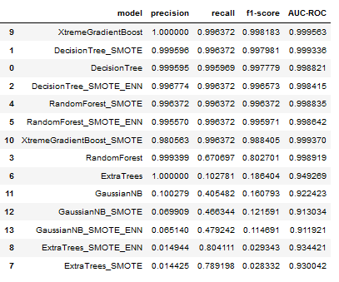
Model Evaluation
This is the model that scored the best, let’s look at the confusion matrix

Slide 9
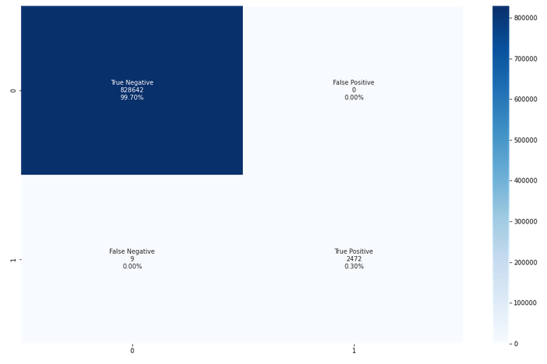
XGBoost Classifier

Slide 10
Summary
Management of Financial Institute
Machine Learning is able to predict the outcome of transaction
We will need to use machine learning methodology on real world data for better fit to each financial institute needs for prediction.

Slide 11
References
https://www.theguardian.com/money/2021/sep/22/fraud-in-uk-at-level-poses-national-security-threat-bank-customers-covid
https://fcase.io/3-current-fraud-threats-which-are-creating-major-challenges-for-the-banking-and-finance-industry/

Slide 12
End of Presentation

